Slide 1

INDIAN INSTITUTE OF INFORMATION TECHNOLOGY KALYANI

Slide 2
Project: Distinct Object Count
Presented By
DEVADI YEKADITYA
MISLAH RAHMAN
SRIRAMSETTY BHANU TEJA
Under the Guidance of
Dr. Amit Ranjan Azad
Assistant Professor, IIIT KALYANI

Slide 3
Presentation Flow:
Project Objective
Technologies Used
Image acquisition
Preprocessing
Segmentation
Analysis
Applications
Scope for improvement
Conclusion
Reference

Slide 4
Project Objective:
To count non overlapping objects from patterns in real world images.

Slide 5
Technologies used:
NumPy
Python doesn’t have native arrays, and the inbuilt list is slow
Efficient C like arrays
Contains various functions for basic matrix manipulations
Images are processed as matrices
OpenCV
Open Source Computer Vision
Specialised library for image processing and analysis

Slide 6
Image Acquisition:
The image should be taken using high quality camera.
The exposure, iso shall be optimal
Low quality images affects the accuracy
6

Slide 7
Preprocessing:
Crop Image:
Using CV2 crop the image
Cropped Image will be returned for processing
Contrast Enhancement:
Convert the image from RGB to HSV
Increase the saturation by 450%
Increase the value by 150%

Slide 8
Preprocessing:
Gaussian Blur:
Reduces the noise
Image Erosion:
Further removes the noise which isn't cleared by gaussian blur

Slide 9
Preprocessing:
Canny Edge Detection
To compensate the error formed during segmentation
Image Dilation
Increase the canny edge thickness
The output of canny edge is dilated using 2x2 convolution matrix

Slide 10
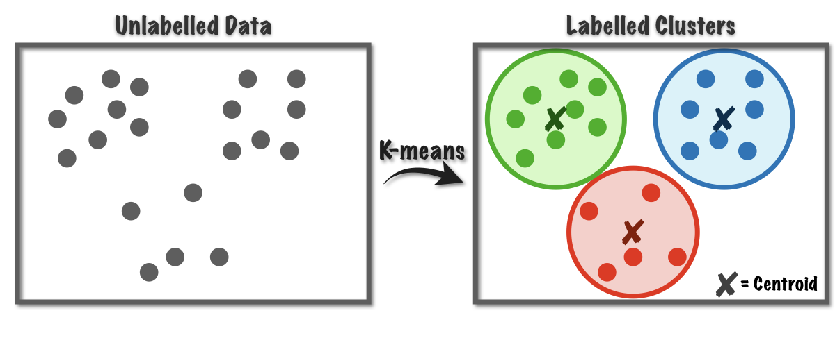
Segmentation:
K-Means Clustering
Unsupervised Algorithm to segment the data interest area from the background.

Slide 11
Optimal Cluster Selection
Select the optimal segment out of 3 clusters
Find the cluster with maximum number of pixels
Merging
Merging the segmented image and canny edges

Slide 12
Analysis:
Contour Mapping
Create a contour map of the segmented image
Counting the number of contours in the first level hierarchy
12

Slide 13
Applications:
Counting object is time consuming, by automation can save time.
Increase productivity and reduce human error

Slide 14
Scope for improvement:
Can mark each object with numbers.
Can be upgraded to android app.

Slide 15
Reference:
Book: Digital Image Processing 3rd ed. - R. Gonzalez, R. Woods.
Yella, Siril and Dougherty, Mark. "Automatically Detecting the Number of Logs on a Timber Truck" Journal of Intelligent Systems, vol. 22, no. 4, 2013, pp. 417-435.
Digital image processing and analysis – Chanda and Dutta Majumder; PHI Learning, 2011.

